Slide 1
Whiskey vs Rum
Woo Junhong

Slide 2
Table of contents
Background
Modeling
01
03
Processing
Conclusion
02
04
Problem statement and goals
Model Analysis and evaluation
Web Scraping, Data Processing, EDA
Recommendation, Going forward

Slide 3
01
Background

Slide 4
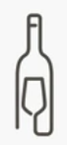
Sing Song Cellar
International alcohol dealer
Good quality of alcohol
First company to air drop alcoholic beverages
Affordable alcohol

Slide 5
Problem statement
Creation of a machine learning model to maximize the efficiency of their marketing spend based on their target audience. Whiskey or Rum?

Slide 6
Goals
Aim To build a classifier that identifies keywords and to classify them to either whiskey or rum based on accuracy

Slide 7

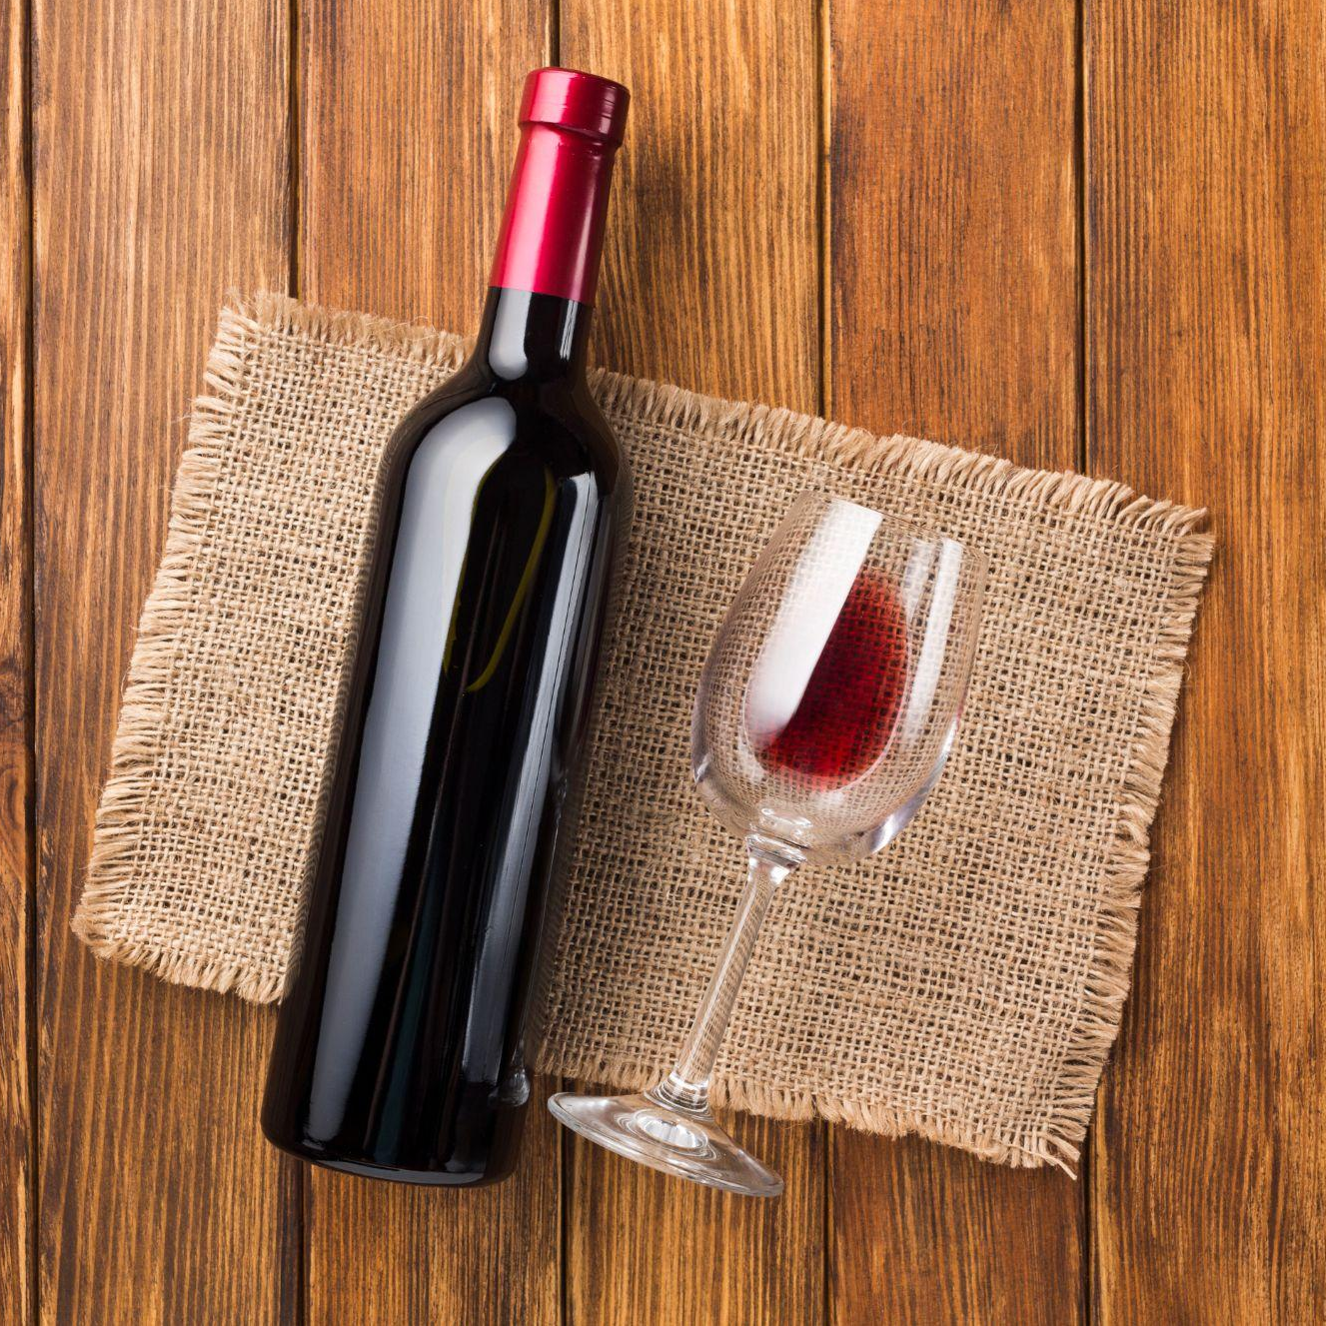
WEB-SCRAPING
r/rum
r/whiskey
PushShift API
At least 10,000 rows

Slide 8

Data Cleaning
Combined title and texts features
Combined into one dataframe
Duplicates removed

Slide 9
Preprocessing text
03
01
Remove links
Remove emojis
02
04
Remove special characters, emoji
Tokenizer and
lemmatizer

Slide 10
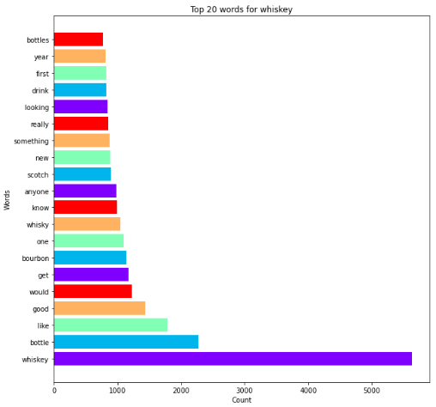
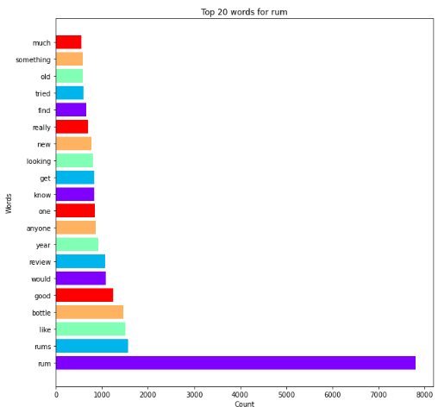
Top Words
r/whiskey
r/rum

Slide 11
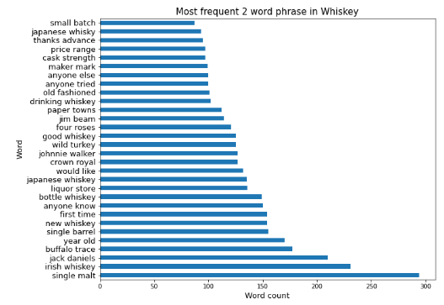
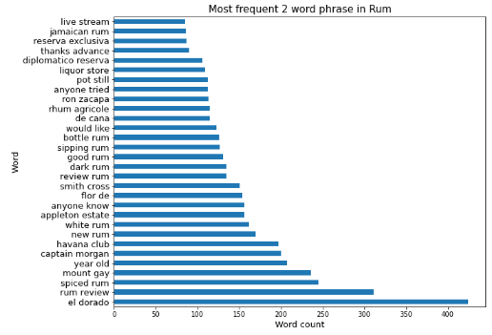
Top 2 word phase
r/whiskey
r/rum

Slide 12
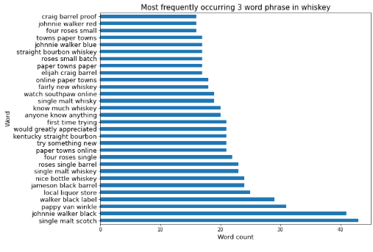
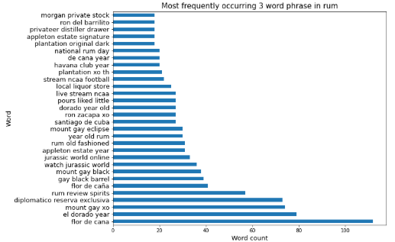
Top 3 word phase
r/whiskey
r/rum

Slide 13
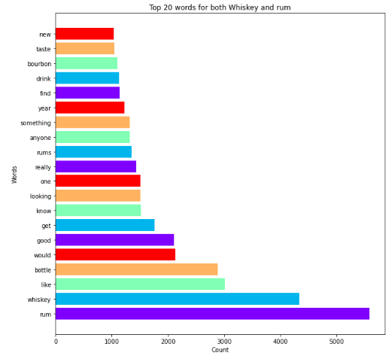
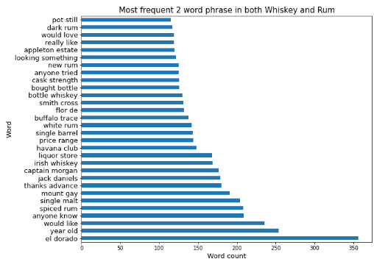
Rum and whiskey top words
For Rum and whiskey

Slide 14
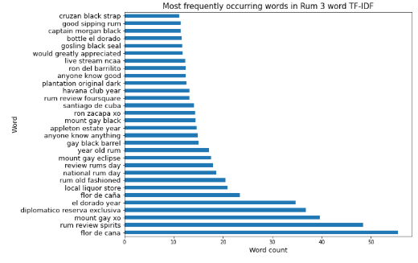
Rum and whiskey top words
For Rum and whiskey

Slide 15
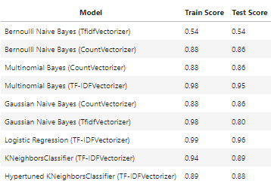
Modeling and Evaluation
Baseline accuracy : 0.54

Slide 16

Model Fitting
Multinomial NB model - TFIDF vectortizer

Slide 17
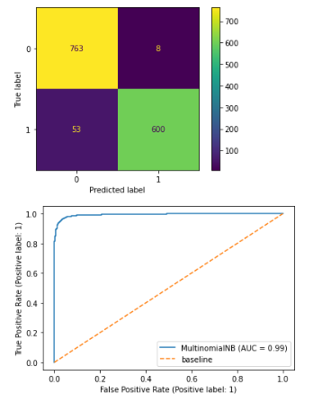
Model Fitting
AUC of 0.99
Better at distinguishing positive and negatives

Slide 18
Recommendations
Explore other models
Limited to 2 subreddits
Add more stop words
More data
Hypertune models
Random Forests Classifier, Ensemble Techniques, etc
Include more subreddits into model
Use more useful words
Other social media platforms
Both vectorizers and model to compare

